Slide 1
Overview of Harambee Team Progression
AS OF JANUARY 2023

Slide 2

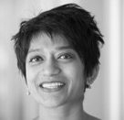
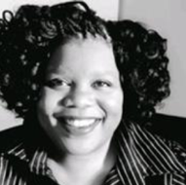
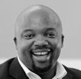
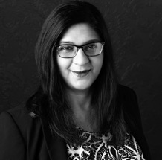
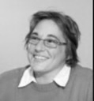





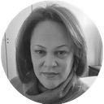
HARAMBEE EXECUTIVES
373
HARAMBEES
Harambee is led by a diverse, highly skilled & experienced executive team
EVAN JONES
Strategy Director
SHARMI SURIANARAIN
Chief Impact Officer
ZENGEZIWE MSIMANG
Chief Communications Officer
MOSOUE SEKONYELA
Chief Government Relations Officer
KASTHURI SONI​
Chief Executive Officer
MARYANA ISKANDER
Chief Executive Officer
PENNY FOLEY
Chief Community Partnerships Officer
A.N.Other (vacant)
Chief Operating Officer
KUBEN NAIR
Technology Director
JOHAN BEETGE-ROSSOUW
Chief Financial Officer
LEBO NKE
Chief Culture Officer
OFFICE OF THE CEO
MARZANNE COLLINS
Executive Advisor
SUDIKA SEKONYELA
Chief of Staff
MEGAN MEYERS
Business Manager

Slide 3

CEO
OFFICE OF THE CEO
People & Culture
Finance
Govern-
ment
Relations
Strategic Communi-cations
Civil Society Coalition Building
Demand Unlocking
Delivery Operations
Impact & Intelligence
Technology & Product
Talent & Engagement
Finance
Government Relations
Stakeholder Management
Coalition Building
Solutions Design & Priority Portfolios/ Projects
Youth Operations
Research & Evidence
Product Design
Learning & Development
Funders
Enablement
Partner Operations
Data Science & Intelligence
Skilling Solutions
Marketing
Project Support Office
Infrastructure & Safety
Place-Based Network
Funder Partnerships
Software Development
Legal
Hospitality
Demand Product Prioritisation
Rwanda
Data
IT Enablement

Slide 4

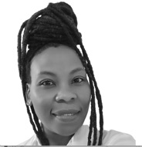
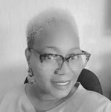
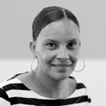
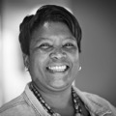
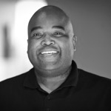
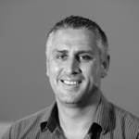
PEOPLE AND CULTURE
19
HARAMBEES
Chief Culture Officer
LEBO NKE
MPHO MOTSHEGOA
Talent and Engagement Head
People
Enablement & Engagement
KHOSI RADEBE
People Enablement Manager
VIANE MICHAEL
People Support Specialist
DENISE MAKHATU
People Admin & Project Coordinator
Recruitment &
Engagement
SHARMANTHA VALJEE
Recruitment Manager
Learning & Development
TSHEPO MAKHANYE
Manager: Learning &
Development
Trainers
ELI BETA
NOKUTHULA GUMEDE
MMATHATO LENTSWE
PORTIA POOE
Coordinator
PINKY CHAUKE
Infrastructure & Safety
Reporting to Sudika Sekonyela (for an interim period)
SHAUN WHITEHEAD
National Manager:
Infrastructure & Safety
Coordinator - MPHO NTOYI
Administrator - TSHEPI RATEMA
Maintenance Tech - KWENA MOREMA
Specialist - THABO KGOMOESWANA
Drivers
SIFISO MNGUNI
SIBUSISO DUBAZANE
SIPHIWE MABUSELA

Slide 5
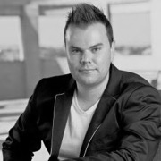

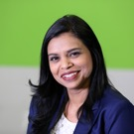
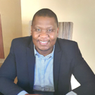
FINANCE, RISK & GOVERNANCE
16
HARAMBEES
Chief Financial Officer
JOHAN BEETGE-ROSSOUW
Finance
KUSELWA MATSILIZA
Finance Manager
SEAN MDLELENI
Financial Accountant
KEMELO TEMBE
Payroll Specialist
LERATO MKHONTO
Finance Officer
XOLANI KUNENE
Finance Officer
MPHO MUTAPA
VACANT
Finance Administrators
Funding
NHLANHA NDABA
Team Leader: Funder Management
ILYAS SULIMAN
Team Leader: Funder Management
UZAIR OSMAN
Project Accountant
KGALALELO MOKGATLHA
Project Accountant
SAM CHETTY
Finance Executive:
Funder Management
KEVIN MTEBULE
Project Officer
SENELISIWE NKOSI
Project Officer
HLUMELO NONXUBA
Project Officer
HELTON MOLOTO
Project Accountant
KGOMOTSO SERIPE
Finance Executive:
Funder Management
Legal
VACANT
Procurement & Contract Manager

Slide 6
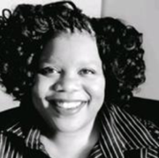







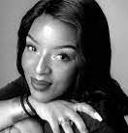


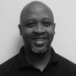
STRATEGIC COMMUNICATIONS
30
HARAMBEES
Chief Communications Officer
ZENGEZIWE MSIMANG
JANA PORTER
Marketing Manager
PAIGE TAVERNA-TURISAN
Marketing Specialist
BONGI KHUMALO
Social Media Manager
NTOKOZO MAKHUBA
Hospitality Manager
NOBAHLE BEKWA
Hospitality Team Leader
Marketing & Hospitality
JABHILE NENE/SANDILE NGAKANE/ANDILE MABOPHE
Front Office Administrators
LEE MKHONZA
Events Manager
BRYONY MAXWELL
Head of Marketing
BOIPELO SEGOMELO, CLAUDIA TSOSANE, BULELWA GEORGE, JULIA MOGWERA, QUEEN NDLOVU, REGINAH TLADI, DIMAKATSO MALEFANE, THOZAMA MKOSANA – Hospitality Assistants
JONATHAN NAJOE
JONATHAN NAJOE
Coordinator: Stakeholder Engagement
Stakeholder Relations Officers
NOTHEMBA XAWUKA
NEO PHOKOTJE
THABISA DLOVA
BRIGHT NGWANA
KELLY ANDREWS
CELESTE DAVIDS
MPUMI KULATI
VACANT
Coordinator : Stakeholder Engagement
Engagement
&
Comms
BABHEKILE PHAKATHI
Coordinator : Stakeholder Engagement
ANELE NGWENYA
Head of
Stakeholder Engagement
DUDU SIMELANE
Engagement Enablement Coordinator
CHRISTOPHER LOUW
Project Manager

Slide 7

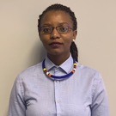


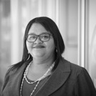
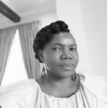
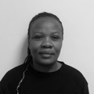
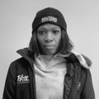
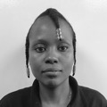

CIVIL SOCIETY COALITION BUILDING
14
HARAMBEES
Chief Community Partnerships Officer
PENNY FOLEY
Coalition Building
YONELA MATYILA
Coalition Officer
PALESA MOPELI
Project Manager
THABILE ADELA NDLOVU
Coalition Building Lead
Civil Society Enablement
THULI NDLOVU
Enablement Facilitator
MATILDA MOKOENA
Enablement Facilitator
TSHOLOFELO POOE
Enablement Facilitator
SIPHIWE MAKALENI
Enablement Facilitator
ELLEN MORTA
Enablement Lead
Place-Based Networks
Youth Network Officers
CHERISE OLIVIER
SIPHESIHLE BHENGU
NOKUKHANYA DLAMINI
MXOLISI NGCOBO
NTOMBIZONKE MATSHWATI
NOKUBONGA GUMBI
Place-based Network
Methodology Lead

Slide 8

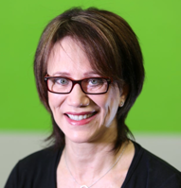




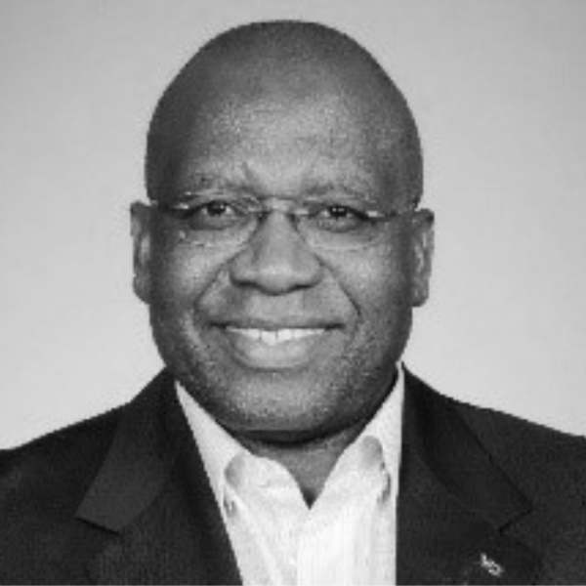
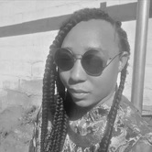

DEMAND UNLOCKING & DELIVERY
30
HARAMBEES
Strategy Director
EVAN JONES
Demand Unlocking
STEPHEN SHIELDS
Executive: Demand
Unlocking & Implementation
KHATIJA VALLIE
Project Manager
Support
DIANNE WOODWARD
Head: DWA & Waterfront
FRAN SWART
Manager: Advocacy & Strategic Relationships
BRETT WILKS
Manager: Demand
Unlocking & Strategic Projects
TIM
ANDREWS
Manager: Digital
Projects
DANIEL NGWEPE
Sector Portfolio Executive
HINA SONI
DWA Programme Manager
TESWILL ARNOLD
DWA Project Co-Ordinator
Partner
Operations
Reporting to Evan for an interim period
SAMANTHA VARNEY
Head: Demand Fulfilment Operations

Slide 9



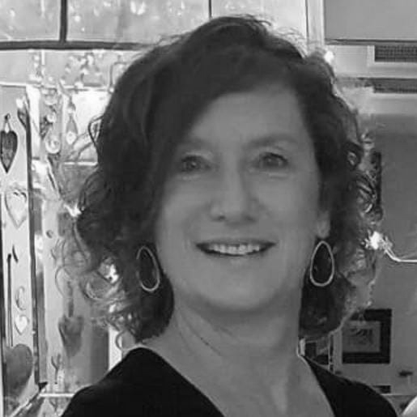

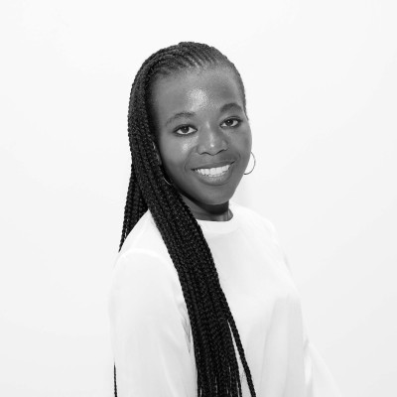
DEMAND UNLOCKING
30
HARAMBEES
Executive: Demand Unlocking
& Implementation
STEPHEN SHIELDS
Product Demand
GUY SHAND
Lead: Product Demand Interface
Portfolio
SINOVUYO MOABALOBELO
Portfolio Executive
FRANK CHIBANDA
Head: Agriculture
MANDI LEVANI
Head: Social & Care Economy
CINDY GOVENDER
Head: Automotive & Incentives
SHERRIE DONALDSON
Head: IRM & Water
Portfolio
TRACEY SWART
Portfolio Executive
DIANNE WOODWARD
Head: DWA & Waterfront
WESLEY PILLAY
Head: DigiLink
TRACEY SWART
Head : GBS
NADIA SOLOMON Project Co-Ordinator
SIPHESIHLE PANGUMSO
QA Test Analyst
SINETHEMBA NONGQOTO
Data Analyst
LERICIA SOLOMONS
Candidate Support
ASHLIN DWARIKA
Team Lead: Software Dev
Portfolio
MARIE-LOUISE FUNSTON
Portfolio Executive
Large & Organised Business
Other Business – Small Medium / Industry Associations
Programme Support Office
Project Managers
SIHLE NDLOVU
RONELL MICHAEL
MALEBA MOLEFE
Client Services Managers
RENÈ RADEMEYER
TAKALANI SALIMANE
XOE MFOKAZI
ITUMELENG MAKOANE
THABO MOTAUNG
KAGISO MONYATSI
SUE HAGEMANN
NANDIPHA ISAACS
Programme Manager

Slide 10
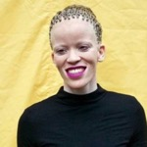
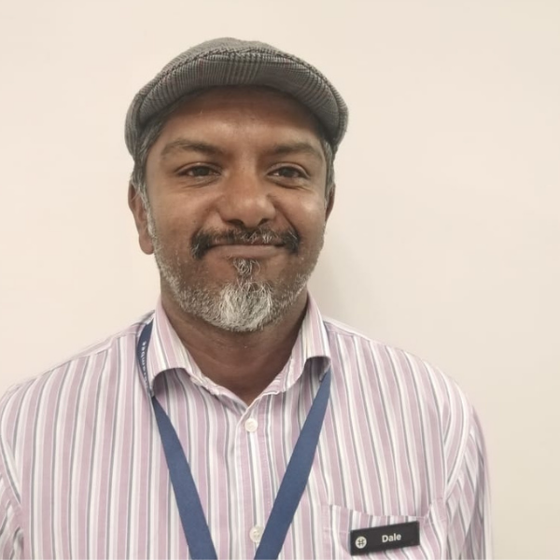
GOVERNMENT RELATIONS
4
HARAMBEE
Chief Government Relations Officer
MOSOUE SEKONYELA
GPG / Tshepo 1 Million
OFENTSE LEKWANE
Portfolio Executive : Government Relations
NOMAHLUBI MOSETHEDI
Head: Provincial Government
Gauteng City Region Academy
DALE JEEVANANTHAM
Programme Manager
Presidential Youth Employment Intervention
VACANT
M&E Coordinator
VACANT
Project Coordinator
TOM LIEBENBERG
Programme Manager
Western Cape
TBD

Slide 11

DELIVERY OPERATIONS
154
HARAMBEES
Chief Operating Officer
TBC
Youth
Operations
HAYLEY CLEMENTS
Head: Network Experience
Partner
Operations
SAMANTHA VARNEY
Head: Demand Fulfilment Operations

Slide 12

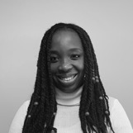
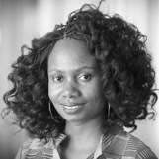
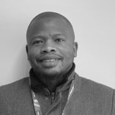
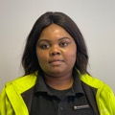
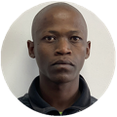
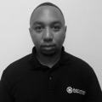
DEMAND DELIVERY & OPERATIONS
39
HARAMBEES
Head: Demand Fulfilment Operations
SAMANTHA VARNEY
Assisted Delivery Support
Delivery Leads
NQOBILE CEBEKHULU
SANE SITHOLE
YANDISWA NGCOZANA
XOLA SPEELMAN
SIYANDA NKANTSU
WENDY KELEMANI
AARIEF SAMODIEN
GUGU DLAMINI
THULA KHUZWAYO
ASWIN ADAMS
AQEEFAH DIXON
SONTI MALINDI
THULI SHABANGU
Assisted Delivery Lead Manager
Delivery Support Team Members
ZOE MEFENYANA
LINDI KHANYILE
MANTUOA MAHLOMAHOLO
QHAMA NOKWALI
ZIZIPHO SAKATA
VUTOMI NGOVENI
AVUYILE GABA
SIZWE JACK
MATIMBA MQANA
ERICK MVULA
NQABA SIZANI
MTHOKOZISI KHUBEKA
KHODANI NEMATEI
Assisted Delivery Support Manager
Partner Desk
& Shared Services
NONKULULEKO GAYI
Partner Desk Support
Team Leader
BRIAN MOOKETSI
Partner Engagement
Team Leader
DANE KIEWEDO
Partner Optimisation
Team Leader
Partner Engagement Officers
Partner Desk Support Officers
LIPELO MQONGOZI
LUBABALO MADLONGOLWANE
MARGARET MNISI/BHEKANI
WANDILE QUPE
NONKULULEKO MUMBA
SAMUKELO MDLIWA
Partner Optimisation Officers
KGALALELO MOSIELENG
PETER LETHURI
KINGSLEY CHARLIE
Partner Desk &
Shared Services Manager
Notes:
What is the change and who is taking on more?
Sam Varney will lead the Demand Delivery and Operations team. In this new role, she will now be taking on accountability for her existing portfolio of partner desk, as well as assisted servicing and self service and will be the Head of all Demand Delivery functions.
Kingsley has been promoted to take on a new role that is a significant change in responsibility. He will now be lead the Partner Desk and Shared Services team in the Demand Delivery and Operations space.
Thuli Shabangu will transition from leading the Vetting. Client services experience
Khodani Nematei brings her People management skills, we are looking forward to her expertise in delivery.

Slide 13

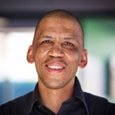

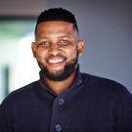
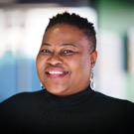
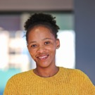
NETWORK EXPERIENCE
115
HARAMBEES
NETWORK EXPERIENCE
Head: Network Experience
HAYLEY CLEMENTS
BRENT DAVIDOFF
Specialist:
Network Experience
LEE KRUGER
Network Experience Project Manager
NELI MZIZI
Network Experience Operations Manager
THABO SEFATSA
Network Experience
Manager
VIWE MANKANKU
Network Experience
Manager
WINDY MOOI
Network Experience
Manager
Network Experience Team Leaders
MANDLA NKOSI
COLLEN MSIMANGA
Contact Centre Administrator
BEVERLY MOKOENA
Network Experience Team Leaders
IKE MOGANE
SHOWAN LEWIS
KEGO BOIKANYO
BANELE MTHETHWA
SINOVUYO GONIWE
Contact Centre Administrator
BOITUMELO SEKGOTHE
Network Experience
Team Leaders
EVENCE NGOBENI
SOLOMON MAJORO
YAMKELA NTLANGULE
NONKULULEKO LUFELE
Contact Centre Administrator
THOKOZILE MLAMBO
Network Experience Guides
s
SOLOMON KUMALO/MILDRED ZWANE/LEHLOHONOLO MODIBA/DUDU MAHLANGU/TSHEPO NKOSI/MOSIDI TSHAKOPE/THANDOLWETHU MBEDZI/ELIZABETH RAMAGAGA/LINDELANI LIEBA/DINEO MOTHOBEKHI/SIPHO KUMALO/NOMTHANDAZO TSHABALALA/GUGU RIKHOTSO/JAN LEKALAKALA/THEMBISILE MPANZA/SANDRA MAZIYA/NOMA GXASHEKA/THAPELO KWENANE/SIYASANGA MDAKA/GONTSE THIBEDI/CECIL SHONGWE/NOKUTHULA HADEBE/PORTIA SIMELANE/LETTY MATLALA/XIKOMBISO SHIVAMBU/MAKOSE MAHLAKO/TSELANE MAKHATHINI/MANTOA MPHUTI/AUMA MAINE/LUCINDA MOKOENA/DZUNANI COSSA/MBALI MAPHANGA/DUDUZILE KHOELI/CYNTHIA BALOYI/BONGANI MNGCINA/LESEGO MOGALE/PHINDILE MASEKO/MAKHOSAZANA NDLOVU/FIHLIWE MALAZA/GUGULETHU MTEMBU/THABISO MOKOENA/RELEBOHILE MOTAUNG/LERATO MOLOI/KGAOGELO NTAMO/NALEDI NTOKE/NTHABISENG MEJE/NICHOLAS PHOPHI/NKULULEKO GUMEDE/BONGIWE THOMO/KOKETSO MOKOBUA/ZODWA KHOZA/COLLEEN TSOTETSI/SIMANGELE ZWANE/NOSIPHO XABA/NTHATHISI PITSO/DINEO MOGOTSI/MAMY PHALANE/SAMUKELO NCUBE/TSHOLOFELO MAELE/TINA MWANDA/IVIWE MBAYO/PENELOPE LANGA/TUMELO MANA/LEBOGANG NQANDA/LAMLILE XIMBA/LETLHOGONOLO MABETWA/SIZWE HLATSHWAYO/TUMISHANG RAFAPA/GODFREY MOTLOI/KWANELE KUNENE/ALICE MASHABA/ANDILE SITHOLE/NTHABISENG MAKGOATHA/PALESA MMUA/VERONICA MAJOLA/DINEO NQANYULA/ZANELE MOSEKI/ELIZABETH MAPHASA/ELELWANI MULAUDZI/MINENHLE MNGUNI/KEARABILWE SEEPAMORE/ /PHIKOLOMZI GELESE/OFENTSE MOREMI/BRENDA LEKONE/ANDILE MSIMANGO/BUSISWA KHANYIWE/SINOMTHA SOKOPO/THANDI MAVODZE/NONSINDISO NGOBESE/MOEKETSI SEGOBO/VUSI MNGUNI/YAMNKELA SOMTSEWU

Slide 14

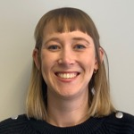
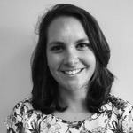
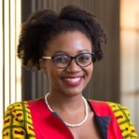
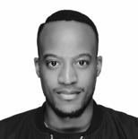
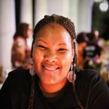
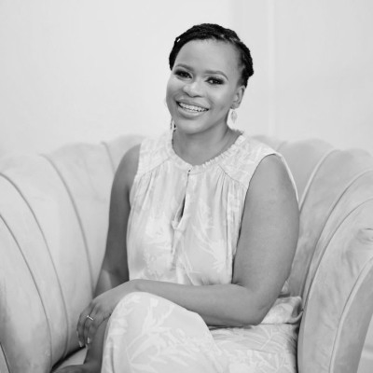
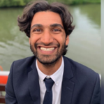
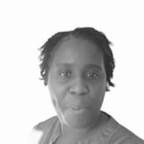
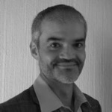
IMPACT & INTELLIGENCE
9
HARAMBEES*
Chief Impact Officer
SHARMI SURIANARAIN
Research & Evidence
KYLA SPARKS
Research & Evidence Specialist
VICTORIA DUNCAN
Research Manager
VACANT
Incubation & Market Intelligence Lead
ROB URQUHART
Head: Research & Evidence
Funder Partnerships & Strategic Projects
NHLANHLA NGULUBE
Data Analyst
XOLILE SEPURU
Project Manager
LUTHO MBONAMBI
LGT Fellow
CHIPO HAMUKOMA
Head: Funder Relationships
& Special Projects
Data Science & Pathway Intelligence
VIOLET EKANDJO
Data Scientist
ALEX BEYERS
BI Analyst
FUAAD COOVADIA
Head: Data Science & Pathway intelligence
*Team totals do not include Service Level Agreement staff members.

Slide 15










RWANDA TEAM
12
HARAMBEES
Regional Manager
HANNAH ADAMS
CHANTAL KAYONGA
Key Accounts Manager
ANGELA RUGO
Strategic Partnerships
JOEL RUGAGI
Employer Partnerships
INNOCENT NDAYIZEYE
English Assessor
MONIQUE EKISA
Bridging Manager
MARIE LOUISE MUKANTWALI
Work-seeker Support Manager
COLOMBE SANGWE
English Assessor
LUCILLE MUJAWAMARIYA English Assessor
CHELSEA SANGWA
English Assessor
QUEEN JOELLE KAMANZI
English Assessor
DAVID BYIRINGIRO
Admin & Finance
KEVIN RWEMA
English Assessor & Online Learning

Slide 16


TECHNOLOGY & PRODUCT
87
HARAMBEES
Technology Director
KUBEN NAIR
Product
BELINDA LEWIS
Chief Product Officer
Platform
HANLIE DE BOD
Chief Information Officer
Youth
Operations
(Reporting to Kuben for an interim period)
HAYLEY CLEMENTS
Head: Network Experience

Slide 17










PRODUCT
25
HARAMBEES
Chief Product Officer
BELINDA LEWIS
Recommendation Engine
MELANIE LAMBERT
Product Manager
IZELLE PEENS
Senior Business Analyst
CARLIE GREEN
Senior Business Analyst
Partner Network
IGNATIUS FERREIRA
Product Manager
TSHEPO MBEWE
Senior Business Analyst
ROSHAN RAMPRSAD
Product Manager
Design
JOSHUA PRETORIUS
Head of Design
JULIA BRISTOW
Senior Product & Service Designer
CY VAN DER SPUY
Product & Service Designer
AMANTLE MOKUBONG
Skilling Manager
DIKELEDI KGANYAGO
Skilling Coordinator
ROBYN PRETORIUS
Skilling Manager
SIVU PRUSENT
Skilling Manager
SONWABO NOTSHULWANA
Skilling Specialist
NICOLE KLOKOW
Skilling Manager
MZOXOLO MASIROE
Skilling Coordinator
Skilling
VEDARSHA SINGH
Skilling Specialist
CHERZELLE GABRIEL
Skilling Specialist
RICARDO RAYNERS
Skilling Specialist (seconded to Digilink)
SIBUSISO MGABHI
Skilling Specialist
HLONI MOLOKOMME
Skilling Coordinator
Assessments & Learning
ROMY DIJKMAN
Manager: Assessments & Learning Content
KEABETSWE MARUMO
Specialist Product & Assessments
TABETH HELA
Skilling
Coordinator
(Seconded to Digilink)
Future
Skills
NKULULEKO MTHIYANA
Skilling Specialist
DigiLink

Slide 18







Chief Information Officer
HANLIE de BOD
PLATFORM
(Data, Software & Testing)
Data
Management
SARAH SMYTH
Data Analyst Lead
FIONA KUNDON
Data Engineering Lead
Senior Data Engineer - GERALD FORBES
Data Engineer – SINDI MIYA/SHAHEER JADA
Junior Data Engineer – MIHIR BABOOLAL
Data Analysts - TECLA CHIRARAMIRO & RAQUEL UNTERSLAK
BONGANI
KGOMONGWE
Head: Data
GISELA RUSHMERE
Business
Intelligence Lead
Business Intelligence Analysts
BENNY DHLAMINI
SYLVESTER SHABALALA
LONDIWE MATIWANE
MZWANDILE MULOVHEDZI
Software Development
​
​STEPHAN VAN DER MERWE/TANAKA TSOKA - Senior Software Developers
​
RIGARD BESTER
Software Development Lead
Testing
Automation Tester – KHOTSO SHOMANG
QA Engineer – NELISA SAHULA/MAUREEN
NQISHA
Software Testers
KEBABETSWE SEPANYA/ONKE DLAMINi
Junior Tester - DYLAN KAROLUS
TSHOLOFELO MAHLANGU
Testing Lead

Slide 19





62
HARAMBEES
Chief Information Officer
HANLIE de BOD
PLATFORM
(IT Enablement)
IT
Enablement
PASCAL RIHM
Technical Support Manager
MASABATA MOSHAPO
Support Coordinator
First Line Support Technicians
BAFANA MLANGENI
SOLLY MALAPANE
THULANI ZWANE
SAMANTHA NKOSI
ANDRE SLABBERT
Data Analysis Manager
KGAUGELO SELAHLE
Data Analyst
Data Analysis Assistants
MOJALEFA MODIBA
JABULISILE TSHABALALA
KGAUGELO SELAHLE
Data Analyst
MOJALEFA MODIBA
Data Analyst Ass.
PULE MOKGORO
Real Time Analyst Lead
BONGINKOSI JIYANE
Real Time Analyst
MAMAPONYA MAFA
Real Time Analyst
LINDIWE BANDA
Real Time Analyst
CHRIS CILENGI
Manager Quality Assurance
QA Team Leaders:
KITSO MTSHALI
ZANELE DLAMINI
Quality Assurance Analysts
CONSTANCE MAMAUWE
SANDILE MGWENYA
KEAMOGETSOE RALEPHENYA
ANGIE RAMOTSHELA
NOSI STOFILE
NONHLANHLA NGQISHA
NOKULUNGA KHUMALO
FAITH SAHULA
XOLISILE LANGA
ANITA KHOSA
ELIZABETH NYAQELA
NKOSANA THUNZI
MBONGENI SOMAKAHLE
NTSIKI NZIMELA
COLLIN LOBAKENG
SENELISIWE ZWANE
NDILEKA FAYINDLADLA
MOHAU NHLAPO
DELVIA MBALATI
MOTSI MOMPEI
Contact Centre Enablement Lead

